Slide 1

Apache Flink
Ricardo Cordeiro, Rui Grafino

Slide 2

Table of Contents
1
Introduction
2
Use Cases
3
Architecture
4
Execution Mode
5
Processing
6
APIs
7
KSQLDB vs Flink SQL Client
8
UI
9
Live Demo
10
Work In Progress

Slide 3

1
Introduction
Distributed stream and batch processing framework
Strengths:
Low-Latency Processing
Fault Tolerance
Event Time Processing
Support for Event-Driven Applications
Notes:
Apache Flink is an open-source stream processing framework for fault-tolerant, scalable, and real-time data processing with support for both event time and batch processing.
Flink distinguishes itself through its specific approach and strengths in the following key areas:
Low-Latency Processing
The design choices and optimizations in Flink contribute to its ability to provide quick insights with minimal delay.
Fault Tolerance
Flink's approach and mechanisms for handling faults, such as stateful recovery and checkpointing.
Event Time Processing
Flink has a robust event time processing model that addresses challenges related to out-of-order events and event time skew.
Support for Event-Driven Applications
Flink is designed to facilitate the development of event-driven applications, making it particularly well-suited for scenarios where responsiveness to events is crucial.

Slide 4





1
Introduction
Notes:
Flink was originally created by Ververica
Flink is used by Alibaba and AWS
Capital One uses Flink for real-time activity monitoring and alerting.
Ebay’s monitoring platform is powered by Flink and evaluates thousands of customizable alert rules on metrics and log streams.

Slide 5

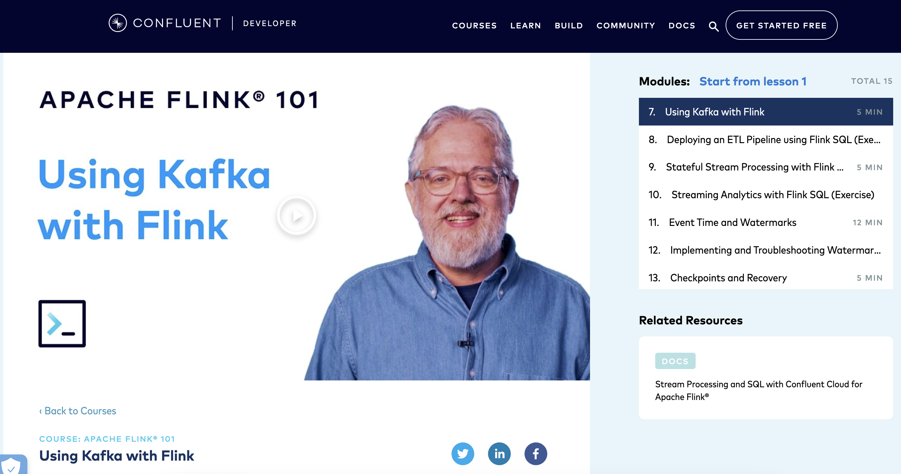
1
Introduction
Notes:
Confluent is adopting and pushing for a Flink integration.
Even currently hosting courses for Flink and Kafka integration.

Slide 6
2
Use Cases
 | Description | Examples
Event-driven applications | A stateful application that ingests events from event streams in real time and reacts | Fraud Detection Rule-Based Alerting
Batch/Streaming Data Analytics | Extract information and insight from raw data | Quality Monitoring Product Analysis
ETL / Data Pipelines | Transform and enrich data and move it across storage systems | Real-time Search Continuous ETL
Notes:
Flink is a good choice for many different types of applications. The most common Use Cases are: (https://flink.apache.org/what-is-flink/use-cases/)
Event-driven applications:
A stateful application that ingest events from one or more event streams in real time and reacts to incoming events by triggering computations, state updates, or external actions. For example Fraud Detection or Rule-Based Alerting.
Not only Batch but also Streaming Data Analytics:
Analytical jobs extract information and insight from raw data.
The results are written to a storage system or emitted as reports. For example Quality Monitoring or Analysis of a Product.
ETL / Data Pipelines:
Transform and enrich data and move it across storage systems
Extract-transform-load (ETL) is a common approach to convert and move data between storage systems.
And Flink is also capable of handling Data Pipelines, the advantage over periodic ETL jobs is the reduced latency of moving data to its destination. Moreover, data pipelines are more versatile and can be employed for more use cases because they are able to continuously consume and emit data.
For example Real-time Search or Continuous ETL

Slide 7
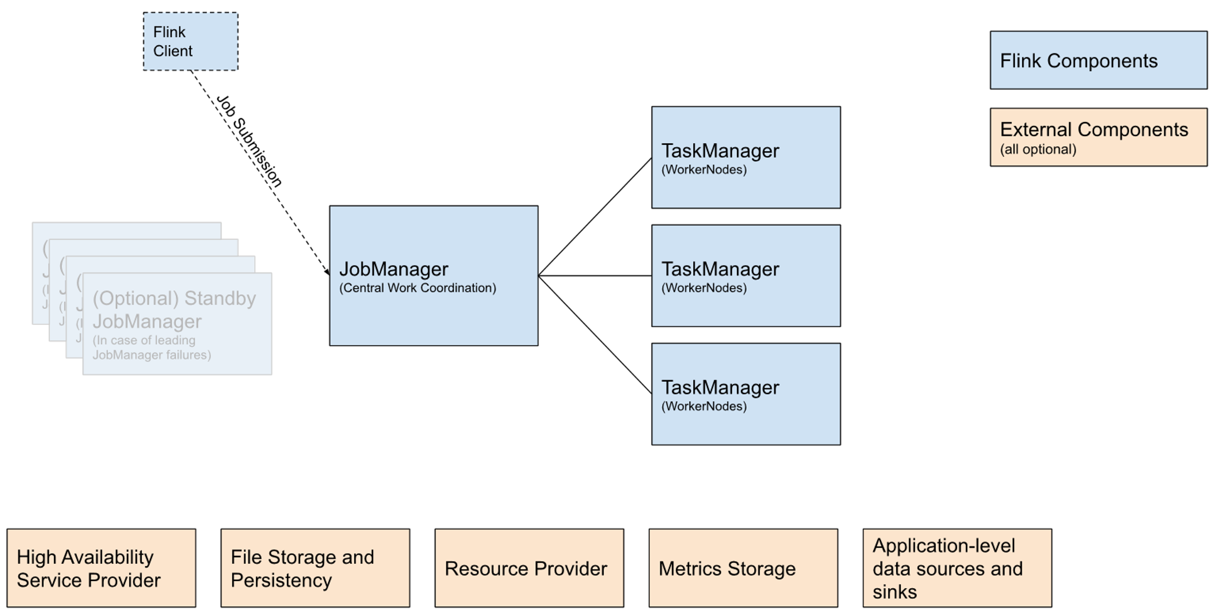
3
Architecture
Controller-Worker Paradigm
Notes:
The figure shows the building blocks of every Flink cluster.
There is always somewhere a client running. the Flink client compiles batch or streaming applications into a dataflow graph, which it then submits to the JobManager. These are things like the Command line interface, a REST endpoint, a SQL client.
The JobManager is the central work coordinator, it distributes the work onto the TaskManagers.
TaskManagers are the services actually performing the work of a flink job.
The external components are all optional and are things like Zookeeper for High-availability, FileSystems for Persistence or Kafka for the application level.

Slide 8
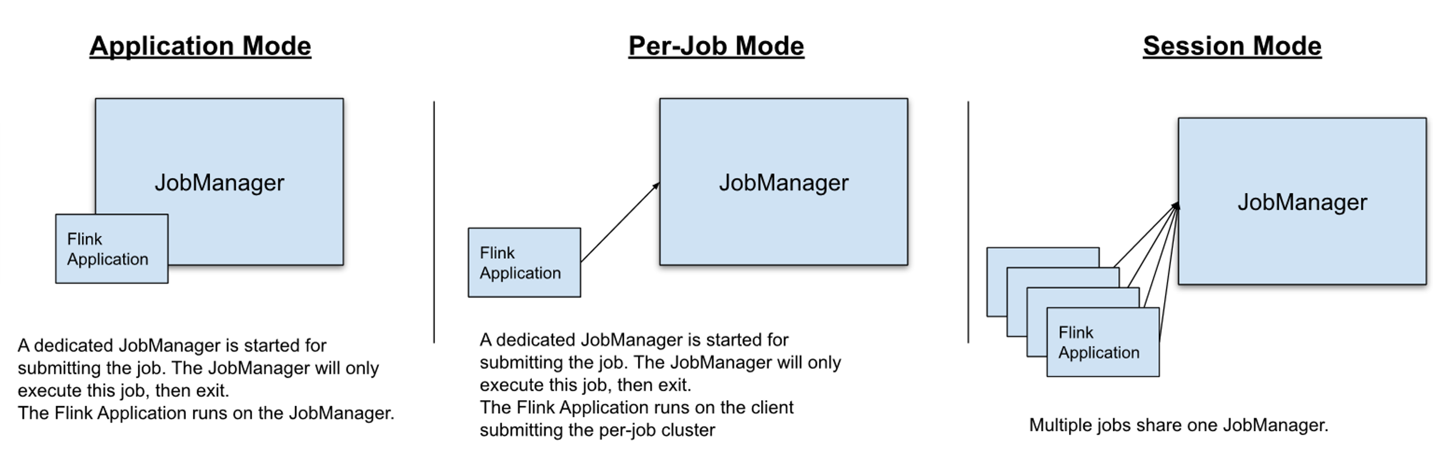
4
Execution Mode
Notes:
The JobManager can be deployed in two modes:
The Application Mode creates a cluster per submitted application. A dedicated JobManager is started for submitting the job. The JobManager will only execute this job, then exit. This process includes downloading the application’s dependencies locally.
Althought Application Mode comes with better resource isolation, it comes at the price of spinning up a dedicated cluster for each application
On the other hand in Session Mode the applications are executed on the client side and one JobManager instance manages multiple jobs that share the same cluster of TaskManagers.
This has the advantage that you do not pay the resorce overhead of spinning up a cluster for every job, however if one of the job fails all jobs running on that specific TaskManager will be affected, which implies a potential massive recovery process. Additionally it adds more load too the JobManager who is responsible for the book-keeping of all the jobs in the cluster.

Slide 9
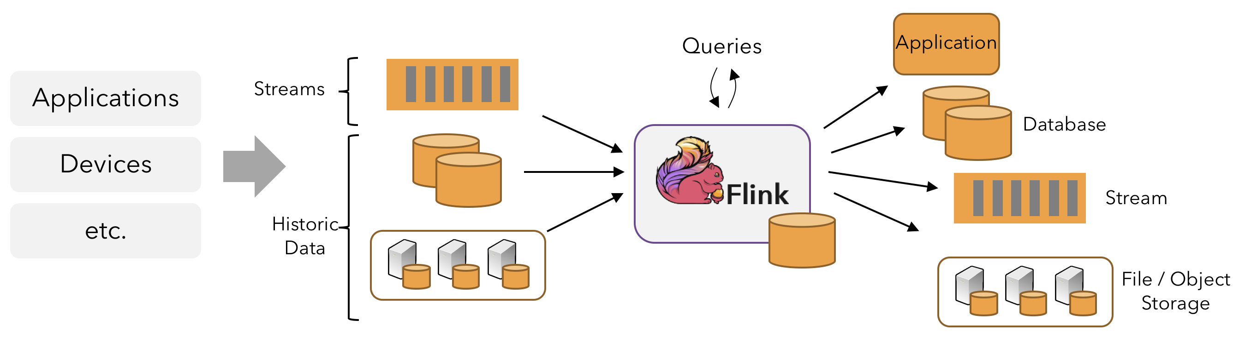
5
Processing
Notes:
In flink applications are composed of streaming data flows that may be transformed by user-defined operators. These dataflows form directed graphs that start with one or more called "sources" and end in one or more called "sinks".
An application may consume real-time data from streaming sources such as message queues or distributed logs, like Kafka. And can also consume historic data from a variety of data sources. Similarly, the streams of results being produced by a flink application can be sent to a wide variety of systems that can be connected as sinks.

Slide 10
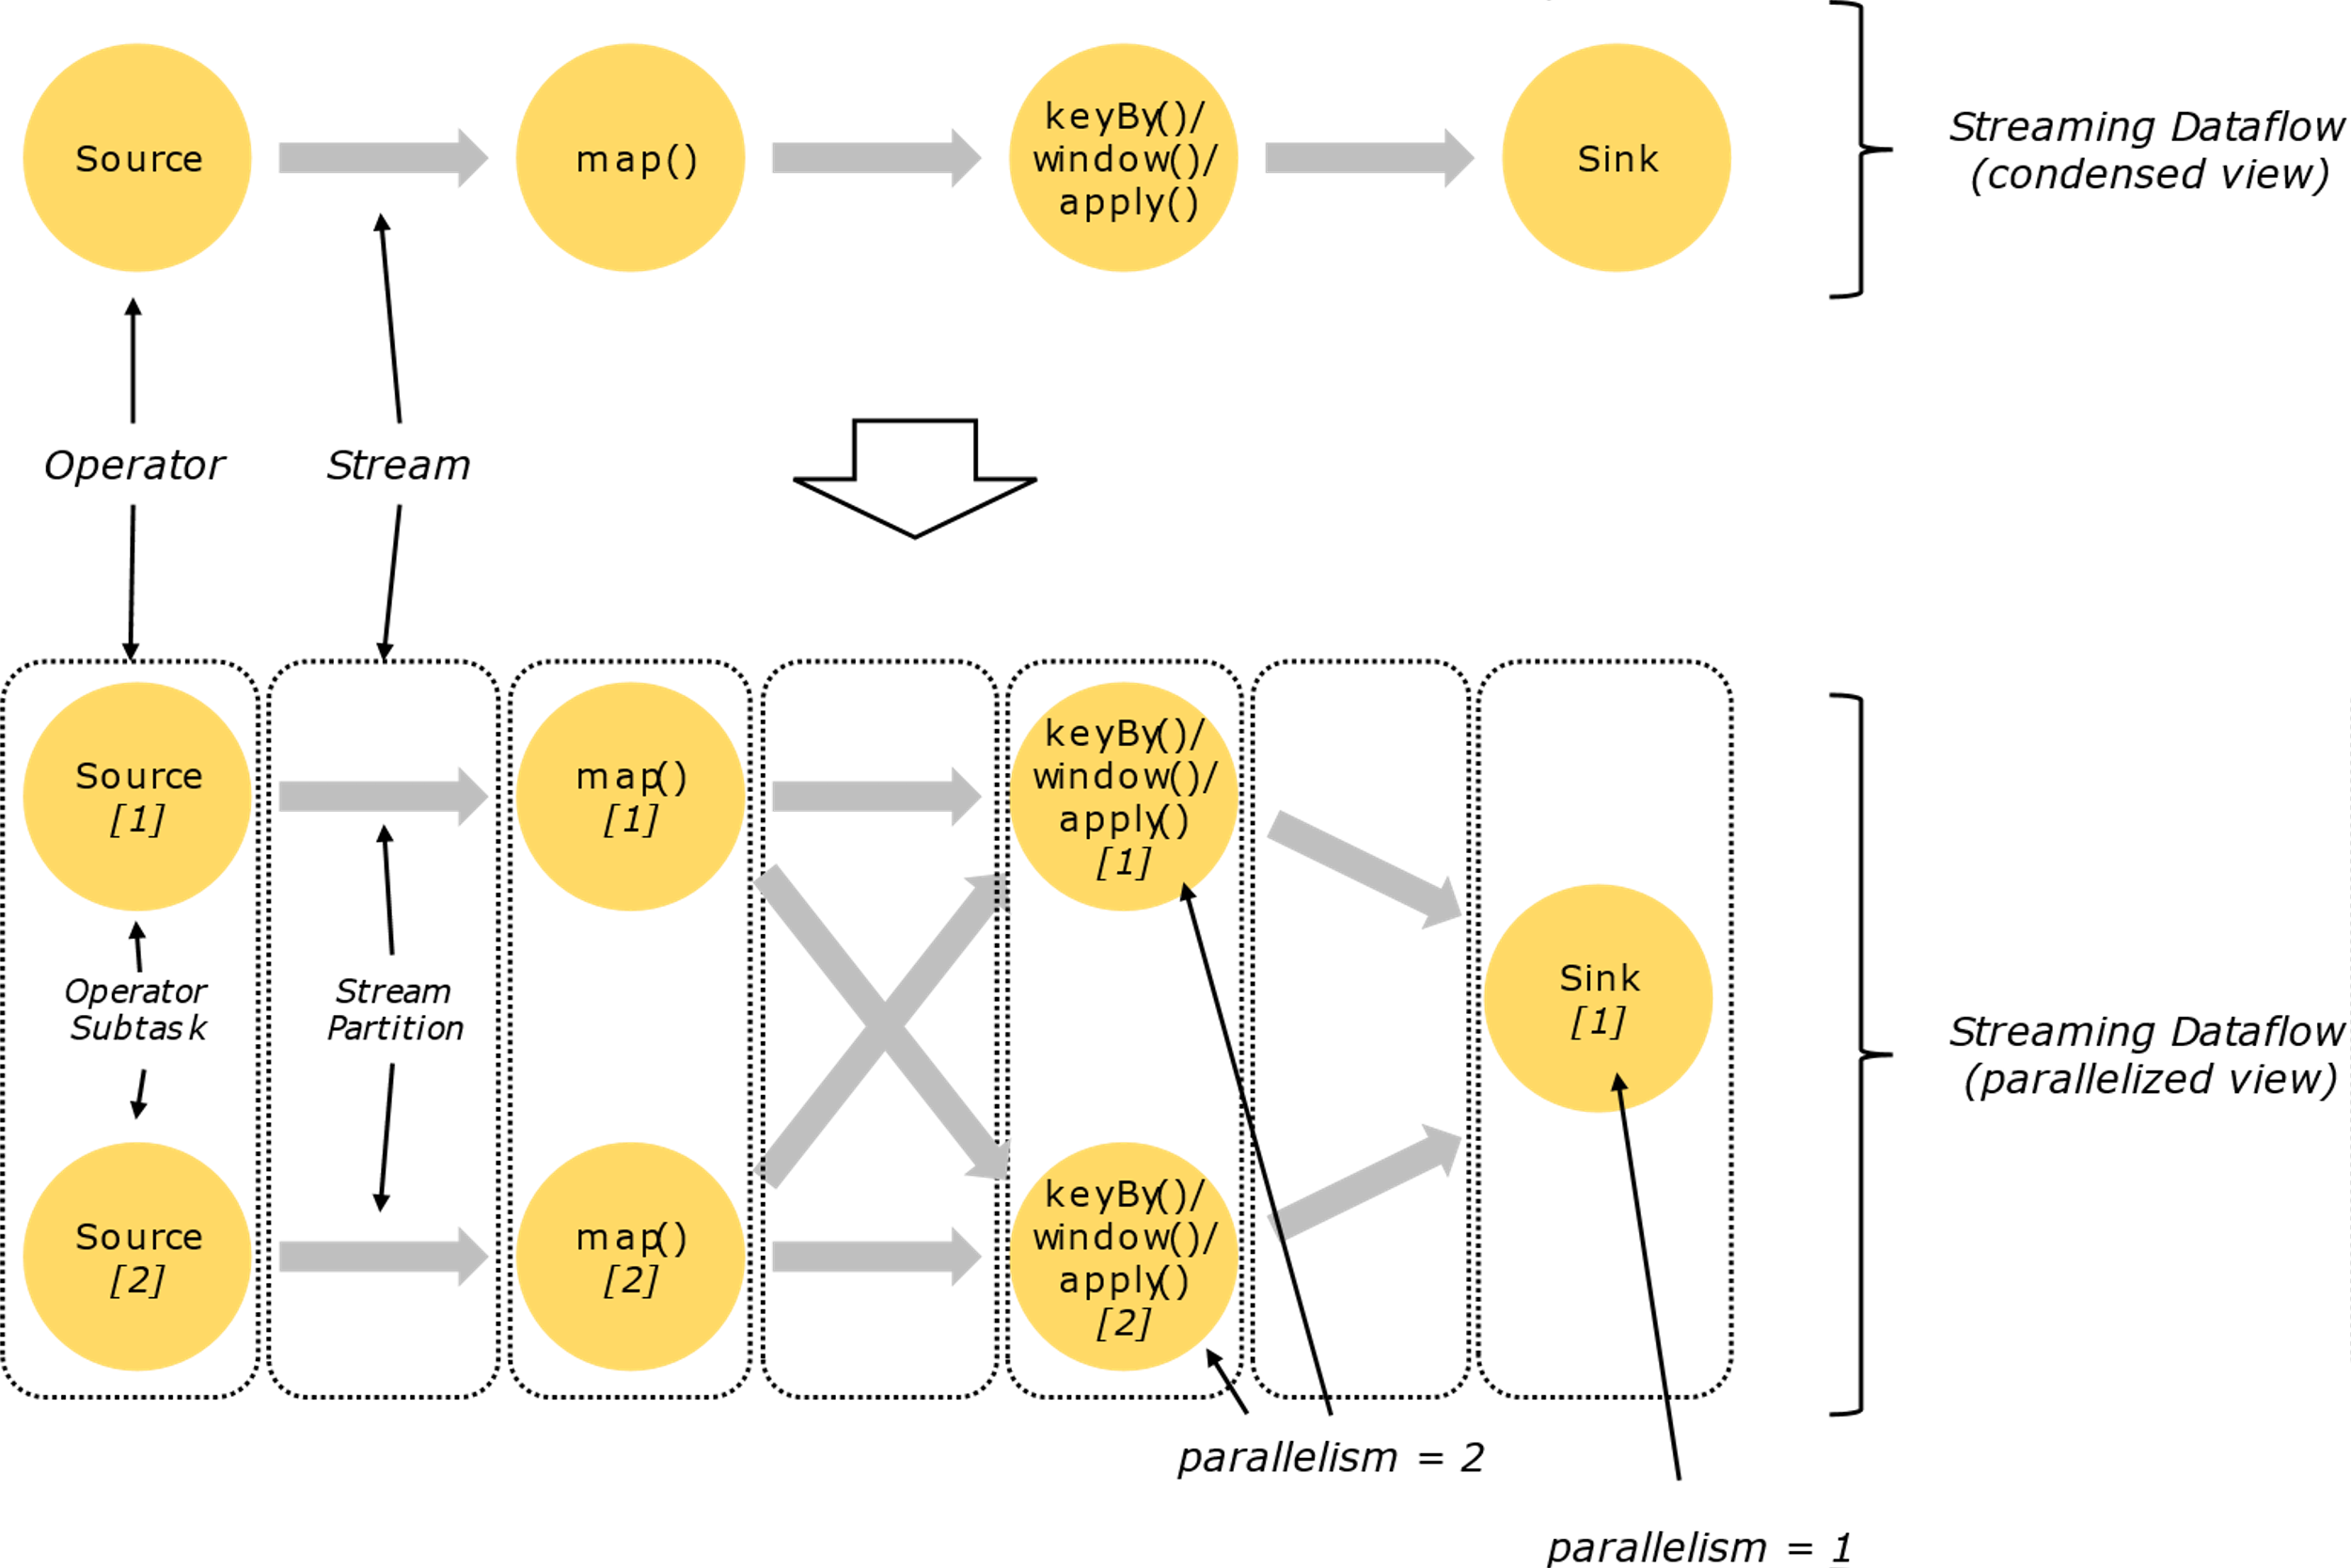
5
Processing
Notes:
Programs in Flink are inherently parallel and distributed. During execution a stream (represented by the arrows in the figure) has one or more stream partitions, and each operator (also represented in the figure, by the tellow circles) has one or more operator subtasks which are independent of one another, and execute in different threads and possibly machines or containers.
The number of operator subtasks is the parallelism of that particular operator. Different operators of the same program may have different levels of parallelism.
Streams can transport data between two operators in a one-to-one pattern, for example between the Source and the map() operators in the figure, this preserves the partitioning ordering, that means that subtask(1) of the map() operator will see the same elements in the same order as they were produced by subtask(1) of the Source operator.
Or in a redistributing pattern, as between map() and keyBy, as well as keyBy and Sink(), the ordering among the elements is only preserved within each pair of sending and receiving subtasks, for example subtask(1) of map() and subtask(2) of keyBy. The redistribution between keyBy and the Sink operators introduces non-determinism regarding the order in which the aggregated results for different keys arrive at the Sink.
----
The diagram below shows a job running with a parallelism of two across the first three operators in the job graph, terminating in a sink that has a parallelism of one. The third operator is stateful, and you can see that a fully-connected network shuffle is ocurring between the second and third operators. This is being done to partition the stream by some key, so that all the events that need to be processed together will be.
State is always accessed locally, which helps flink applications achieve high throughput and low-latency. You can choose to keep state on the JVM heap, or if it is too large, in efficiently organized on-disk data structures.

Slide 11
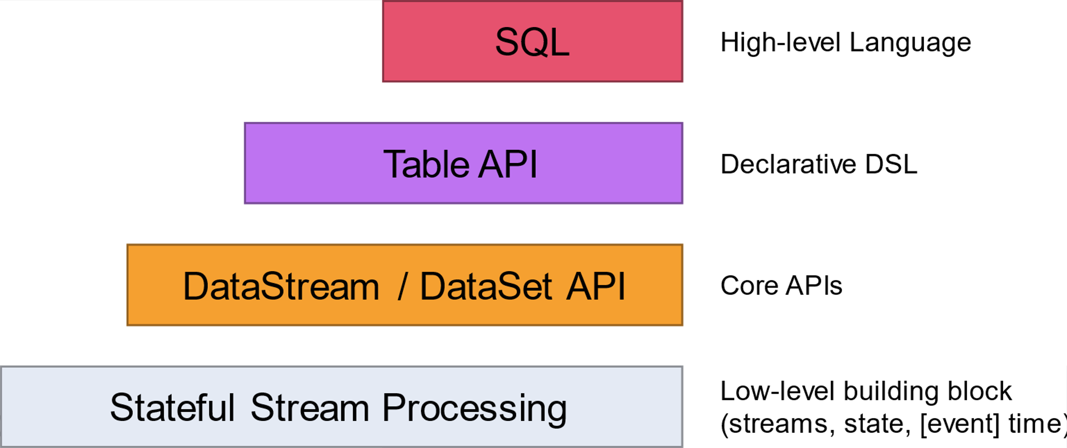
6
APIs
Notes:
Flink offers different levels of abstraction for developing applications.
Stateful stream processing is the lowest level of abstraction, allows programs to realize sophisticated computations.
In practice, many applications do not need a low-level abstraction and can instead use the Core APIs. Joins, aggregations, etc, written in the respective programming language that also offer additional primitives on data sets, like loops or iterations.
The Table API is a declarative DSL centered around tables, which may be dynamically changing. It is less expressive than the Core APIs, but require less code and are more concise to use.
The highest level abstraction by flink is SQL.
The low level functions integrates with the DataStream api and one can seamlessly conventert between tables and Datastreams or DataSets, allowing programs to mix APIs.

Slide 12
6
APIs
# Create table statement
create_table_sink = """
CREATE TABLE sink (
user_id BIGINT,
item_id BIGINT,
) WITH (
'connector' = 'kafka',
'topic' = 'sink',
'scan.startup.mode' = 'earliest-offset',
'properties.bootstrap.servers' = 'kafka-0:9092',
'format' = 'json'
)
""" # Execute CREATE TABLE statement
table_env.execute_sql(create_table_user_behavior)
Notes:
Language-integrated API for Scala, Java and Python
Example is using the Table API in a python program.

Slide 13
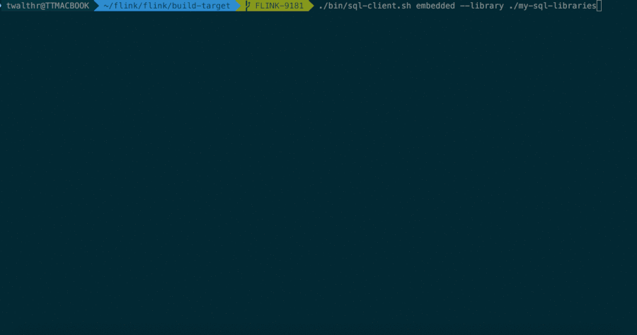
6
APIs
Notes:
SQL-Client example

Slide 14
7
KSQLDB vs Flink SQL Client
 | KsqlDB | Apache Flink
Purpose | Real-time stream processing and analytics in Kafka ecosystem | Distributed stream processing framework with a broader scope
Language and API | SQL-like language for stream processing queries | SQL-like language with extensions for stream processing queries that offer programmatic flexibility
State Management | Relies on Kafka for state storage | Support for several distributed state storages
Community | Large open-source community less active lately with focus on Kafka. | Large and active open-source community not limited to Kafka.
Integrations | Kafka only ecosystem | Support for diverse data sources and sinks
Processing | Streaming | Streaming and Batch
Notes:
KSQLDB and Flink SQL Client are both tools that provide SQL-like interfaces for stream processing, but they have some differences in terms of architecture, features, and use cases:
Purpose:
- KSQLDB: Real-time stream processing and analytics in Kafka ecosystem
- Flink SQL Client: Distributed stream processing framework with a broader scope
Language and API:
Both use a SQL-like language. Flink SQL has extensions for handling event time, windowing and other streaming concepts
State Management:
- KSQLDB: Leverages Kafka for state storage, providing fault tolerance and scalability.
- Flink SQL Client: Has support for several distributed state storages, providing fault tolerance and high availability and even event time and processing time semantics.
Community:
- KSQLDB: Large open-source community less active lately with focus on Kafka.
- Flink SQL Client: Large and active open-source community that is not limited to Kafka.
Integrations:
- KSQLDB: Well-suited for scenarios where the primary data source and sink are Kafka topics, and the focus is on building applications around Kafka events.
- Flink SQL Client: Suitable for a wider range of use cases, like i mentioned, event-driven applications, ETL pipelines, machine learning, and general-purpose data processing.
Processing:
- KSQLDB: Handles Streaming
- Flink SQL Client: Handles both Streaming and Batch

Slide 15
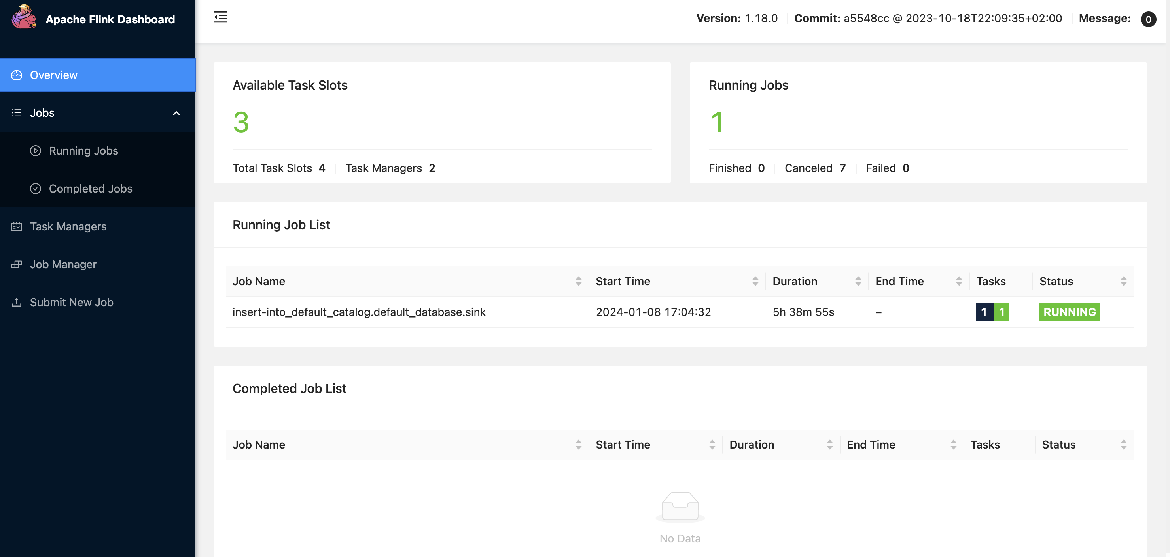
8
UI
Notes:
UI

Slide 16
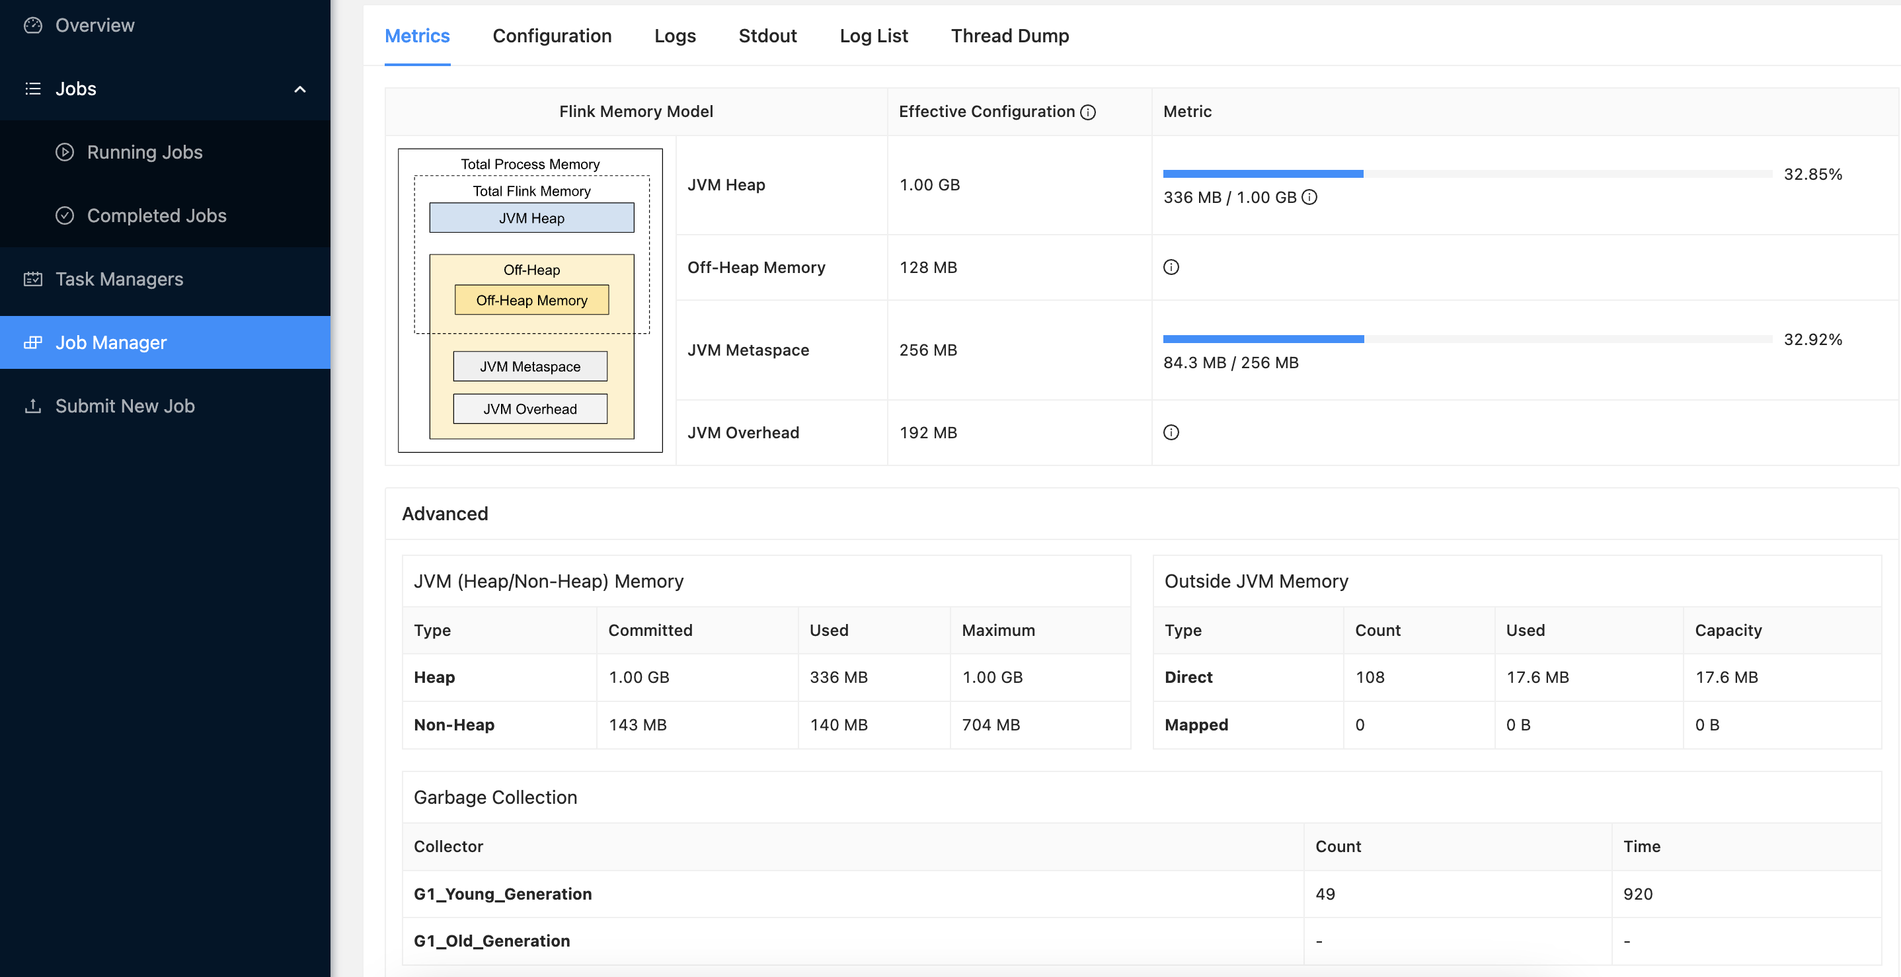
8
UI
Notes:
UI

Slide 17
9
Live Demo
A very simple scenario in Flink SQL client
Notes:
Present Demo

Slide 18
10
Work In Progress
Assess requirements, versions and binaries
K8s deployment with State and Checkpoints
K8s deployment with High-Availability
K8s deployment with correct requests and limits
Avoid Flink's Kubernetes native Operator
Presentation regarding PyFlink
Automate configurations
Assess metrics
Test everything (Performance, Failover, etc..)

Slide 19
Ricardo Cordeiro, Rui Grafino

